Slide 1
Luca Porcu & Chandra Chilamakuri (Bioinformatics core)
21st February 2025
Linear regression models
Fixed-effects models

Slide 2
Process flow
Stage 1
Stage 2
Stage 3
Stage 4
Effects and regression models
Analysis of variance (ANOVA)
Simple regression model
Multivariable regression model

Slide 3
Analysis of variance (ANOVA)
Treatment 1 mean
Treatment 1 deviation
Overall mean
Treatment 2 deviation
Treatment 2 mean
Definition and classification
Individual deviation
10.00 -10.20 am
Qualitative predictor

Slide 4
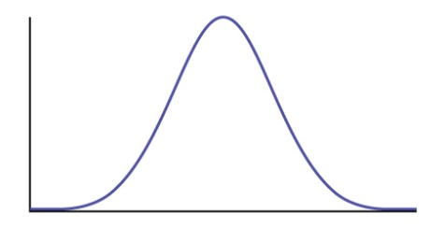
Fisher’s one-way ANOVA
4
1. The unit k (e.g. mouse), k = 1,…,u_{i}; N = 𝝨_{i} u_{i}
Equation of the statistical model:
y_{ik} = μ + τ_{i} + ε_{ik}
2. τ_{i}: effect of treatment i, i = 1,…,n
3. ε_{ik}: the random part of the model (i.e. error term of the model). It is a blanket characterization of the uniqueness of the k_{th} unit assigned to group i
Treatment assignment
Group₁
𝝁
Group₂
Group₃
Assumptions of ANOVA (ANalysis Of VAriance) models are the following:
The effect of each treatment level i is additive on 𝝁 (i.e. population mean) parameter
ε_{ik} is assumed to be independent of one another and normally distributed with mean = 0 and common standard deviation = σ

Slide 5
Fisher’s one-way ANOVA
5
Hypothesis to test: 𝝉₁ = … = 𝝉_{n} = 0
Test statistic:
Source of variation | Sum of Squares | Degrees of freedom | Mean Squares | F_{df1,df2} | p-value
Treatment | SSB = 𝝨_{i} u_{i} (m_{i} - M)² | df₁ = n -1 | MSB = SSB / df₁ | MSB / MSE | 0.023
Residuals | SSE = 𝝨_{i} 𝝨_{k} (y_{ik} – m_{i})² | df₂ = N - n | MSE = SSE / df₂
Total | SST = SSB + SSE
Legend: m_{i} is the sample mean of group i. M is the overall mean response
Note: the ANOVA divides the total variation in the response into parts.
R implementation
Step | Aim | R function
1 | We should fit our data to the ANOVA model | fitModel = lm(Response ~ Treatment, data=dSet)
2 | We can get R to produce an ANOVA table | anova(fitModel)

Slide 6
Fisher’s two-way ANOVA
6
1. The unit k (e.g. mouse), k = 1,…,u_{ij}; N = 𝝨_{ij} u_{ij}
Equation of the statistical model:
y_{ijk} = μ + τ_{i} + 𝜼_{j} + ε_{ijk}
2. τ_{i}: effect of treatment i, i = 1,…,n; 𝝶_{j}: effect of treatment j, j = 1,…,r
3. ε_{ijk}: the random part of the model (i.e. error term of the model). It is a blanket characterization of the uniqueness of the k_{th} unit assigned to group ij
Treatment assignment
Group_{1B}
Group_{2B}
Group_{3B}
𝝁
Group_{1A}
Group_{2A}
Group_{3A}

Slide 7
Fisher’s two-way ANOVA
7
Hypothesis to test n.1: 𝝉₁ = … = 𝝉_{n} = 0
Hypothesis to test n.2: 𝜼₁ = … = 𝜼_{r} = 0
Test statistic:
Source of variation | Sum of Squares | Degrees of freedom | Mean Squares | F_{df1,df2} | p-value
Treatment 𝝉 | SSB_{𝝉} = 𝝨_{i} u_{i} (m_{i} - M)² | df1_{𝝉} = n - 1 | MSB_{𝝉} = SSB_{𝝉} / df1_{𝝉} | MSB_{𝝉} / MSE | 0.023
Treatment 𝜼 | SSB_{𝜼} = 𝝨_{j} u_{i} (m_{j} - M)² | df1_{𝜼} = r - 1 | MSB_{𝜼} = SSB_{𝜼} / df1_{𝜼} | MSB_{𝜼} / MSE | 0.150
Residuals | SSE = 𝝨_{ij} 𝝨_{k} (y_{ijk} – m_{ij})² | df₂ = N - (n ⋅ r) | MSE = SSE / df₂
Total | SST = SSB_{𝝉} + SSB_{𝜼} SSE
Note: the ANOVA divides the total variation in the response into parts.
R implementation
Step | Aim | R function
1 | We should fit our data to the ANOVA model | fitModel = lm(Response ~ Treat_{𝝉} + Treat_{𝜼}, data=dSet)
2 | We can get R to produce an ANOVA table | anova(fitModel)

Slide 8
Fisher’s two-way ANOVA with interaction
8
1. The unit k (e.g. mouse), k = 1,…,u_{ij}; N = 𝝨_{ij} u_{ij}
Equation of the statistical model:
y_{ijk} = μ + τ_{i} + 𝜼_{j} + τ_{i}:𝜼_{j} + ε_{ijk}
2. τ_{i}: effect of treatment i, i = 1,…,n; 𝝶_{j}: effect of treatment j, j = 1,…,r
3. ε_{ijk}: the random part of the model (i.e. error term of the model). It is a blanket characterization of the uniqueness of the k_{th} unit assigned to group ij
Treatment assignment
Group_{1B}
Group_{2B}
Group_{3B}
𝝁
Group_{1A}
Group_{2A}
Group_{3A}

Slide 9
Fisher’s two-way ANOVA with interaction
9
Hypothesis to test n.1: 𝝉₁ = … = 𝝉_{n} = 0
Hypothesis to test n.2: 𝜼₁ = … = 𝜼_{r} = 0
Hypothesis to test n.3: 𝝉:𝜼 = 0
Test statistic:
Source of variation | Sum of Squares | Degrees of freedom | Mean Squares | F_{df1,df2} | p-value
Treatment 𝝉 | SSB_{𝝉} = 𝝨_{i} u_{i} (m_{i} - M)² | df1_{𝝉} = n - 1 | MSB_{𝝉} = SSB_{𝝉} / df1_{𝞃} | MSB_{𝝉} / MSE | 0.023
Treatment 𝜼 | SSB_{𝜼} = 𝝨_{j} u_{i} (m_{j} - M)² | df1_{𝜼} = r - 1 | MSB_{𝜼} = SSB_{𝜼} / df1_{𝝶} | MSB_{𝜼} / MSE | 0.150
Interaction 𝝉:𝜼 | SSB_{𝝉:𝜼} = 𝝨_{jj} u_{ij} (m_{ij} - m_{j} - m_{i} + M)² | df1_{𝝉:𝜼} = (n - 1) ⋅ (r - 1) | MSB_{𝝉:𝜼} SSB_{𝝉:𝜼} / df1_{𝝉:𝜼} | MSB_{𝝉:𝜼} / MSE | 0.401
Residuals | SSE = 𝝨_{ij} 𝝨_{k} (y_{ijk} - m_{ij})² | df₂ = N - (n ⋅ r) | MSE = SSE / df₂
Total | SST = SSB_{𝝉} + SSB_{𝜼}+ SSB_{𝝉:𝜼} + SSE
Note: the ANOVA divides the total variation in the response into parts.
R implementation
Step | Aim | R function
1 | We should fit our data to the ANOVA model | fitModel = lm(Response ~ Treat_{𝝉}* Treat_{𝜼}, data=dSet)
2 | We can get R to produce an ANOVA table | anova(fitModel)

Slide 10
Diagnostics: residuals
10
Fitted value = Treatment 1 mean
The (raw) residuals are equal to the difference between the observations and the corresponding fitted values.
Residual = Observed - Fitted
Fitted value = Treatment 2 mean
R implementation
Step | Aim | R function
1 | We should fit our data to the ANOVA model | fittedModel = lm(Response ~ Predictor, data=dSet)
2 | We want to obtain the residuals of the model | dSet$resid = resid(fittedModel)

Slide 11
Diagnostics: residuals
11
Shapiro-Wilk normality test
data: dSet$resid
W = 0.97324, p-value = 0.3119
Bartlett test of homogeneity of variances
data: resid by Predictor
Bartlett's K-squared = 1.5374, df = 1, p-value = 0.215
R implementation
Step | Aim | Tool | R function
1 | We should plot the residuals | Histogram | hist(dSet$resid)
 |  | Q-Q plot | qqnorm(dSet$resid); qqline(dSet$resid)
2 | We could test the assumptions | Shapiro-Wilk normality test | shapiro.test(dSet$resid)
 |  | Bartlett’s homoscedasticity test | bartlett.test(resid ~ Predictor, data = dSet)

Slide 12
Diagnostics: residuals
12
Equation of the statistical model:
y_{ijk} = μ + τ_{i} + 𝜼_{j} + τ_{i}:𝜼_{j} + ε_{ijk}
Assumptions of normality and homoscedasticity must be satisfied by residuals of single treatment group and combined treatment groups (e.g. pooled residuals of Group_{1A}, Group_{3A} and Group_{3B}).
Pooled residuals should be examined in the diagnostic analysis.

Slide 13
Source of problems and possible solutions
13
Solution | Normality | Unequal variance | Outliers
Welch’s one-way ANOVA |  | ✓
Weighting |  | ✓
Distribution-free methods ⨀ | ✓ | ✓ | ✓
Data transformation | ✓ | ✓ | ✓
⨀ e.g. Kruskal-Wallis test (i.e. one-way ANOVA on ranks)

Slide 14
Welch’s one-way ANOVA
14
The Welch version of one-way ANOVA do not assume that all the groups are sampled from populations with equal variances.
Treatment assignment
Hypothesis to test: 𝝉₁ = … = 𝝉_{n} = 0
Equation of the statistical model:
y_{ik} = μ + τ_{i} + ε_{ik}
Group₁
𝝁
Group₂
Group₃
σ₁
σ₂
σ₃
Assumptions of Welch’s one-way ANOVA models are the following:
The effect of each factor is additive on 𝝁 (i.e. population mean) parameter
ε_{ik} is assumed to be independent of one another and normally distributed with mean = 0. Standard deviation could be different between groups: σ_{i} ≠ σ_{j}, i ≠ j.

Slide 15
Weighted least squares
15
> library(nlme) # Load the nlme package
> fittedModel = gls(Response ∼ Predictor, weight = varIdent(form= ∼1 | Predictor) , data = dSet)
# Modeling variance as function of the predictor
> summary(fittedModel) # Output
Variance function:
Structure: Different standard deviations per stratum
Formula: ~1 | gender
Parameter estimates:
F M
1.0000000 0.7786179
Coefficients:
Value Std.Error t-value p-value
(Intercept) 147.4729 3.725061 39.58938 0.0000
gender M 4.9198 5.097216 0.96519 0.3368
Output
Note: gls() function fits a linear model using generalized least squares.

Slide 16
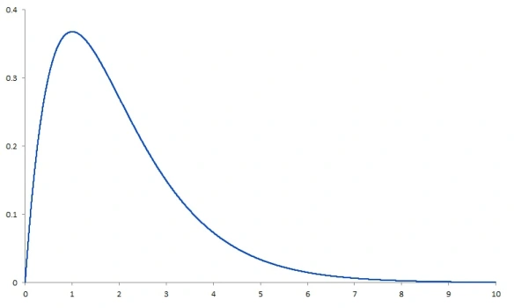
Kruskal-Wallis test
16
The Kruskal-Wallis test (i.e. one-way ANOVA on ranks) works on ranks. It tests whether samples originate from the same distribution.
Hypothesis to test: D₁ = … = D_{n}
10.2 | 24.7 | 33.2 | .. | 96.4 | 99.9
Replacement of data by ranks
1 | 2 | 3 | .. | N-1 | N
Assumptions of Kruskal-Wallis test are the following:
We only assume that the observations in the data set are independent of one another.

Slide 17
R functions
17
R implementation
Test | R
Welch’s one-way ANOVA | Function | oneway.test(Response ~ Predictor, data = dSet, var.equal = FALSE) | oneway.test(Response ~ Predictor, data = dSet, var.equal = FALSE)
 | Output | One-way analysis of means (not assuming equal variances) data: Response and Predictor F = 118.34, num df = 1.000, denom df = 45.143, p-value = 3.342e-14 | One-way analysis of means (not assuming equal variances) data: Response and Predictor F = 118.34, num df = 1.000, denom df = 45.143, p-value = 3.342e-14
Weighted least square | Function | fittedModel <- gls(Response ~ Predictor, weights = varIdent(form= ~ 1|Predictor), data = dSet) summary(fittedModel) | fitModel <- gls(Response ~ Pred1, weights = varIdent(form= ~ 1|Pred1), data = dSet) summary(fitModel)
 | Output | Variance function: Structure: Different standard deviations per stratum Formula: ~1 | Predictor Parameter estimates: 1 2 1.000000 1.293192 Coefficients: Value Std.Error t-value p-value (Intercept) -0.001177 0.1890228 -0.006228 0.9951 Predictor 3.361487 0.3090014 10.878548 0.0000
Kruskal-Wallis | Function | kruskal.test(Response ~ Predictor, data = dSet)
 | Output | Kruskal-Wallis rank sum test data: Response by Predictor Kruskal-Wallis chi-squared = 34.222, df = 1, p-value = 4.917e-09

Slide 18
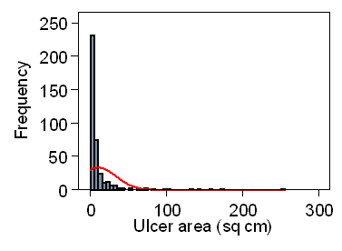
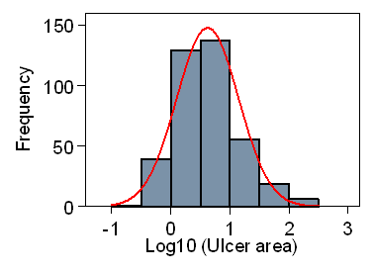
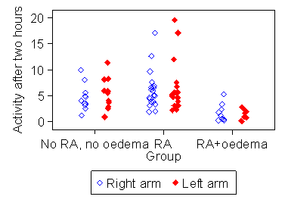
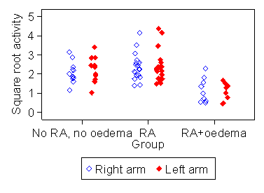
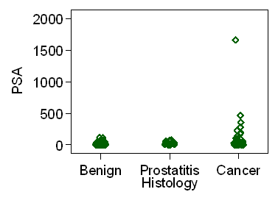
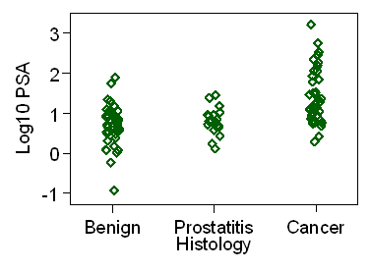
Data transformation
18
We can transform the data mathematically…
to make them fit the normality
more closely
to obtain more similar variances
to handle outliers

Slide 19
Data transformation
19
Common and useful transformations of the response variable:
1. the logarithm (y_{i} > 0, i=1,…n)
2. the square root (y_{i} > 0, i=1,…n)
3. the square power (y_{i} > 0, i=1,…n)
4. the ranks (e.g. Welch’s one-way ANOVA on ranks)

Slide 20
Hands on
https://bioinformatics-core-shared-training.github.io/ Fixed-and-Mixed-effects-models/

